Slide 1

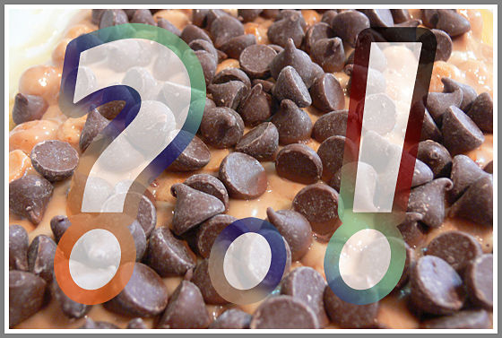
Types of Sentences

Slide 2



“I DIE” for sentences
I (Interrogative)
D (Declarative)
I (Imperative)
E (Exclamatory)
or

Slide 3



Interrogative Sentences
This type of sentence asks a question. It ends with a question mark.
What do panda bears eat?
Who studied for their test last night?
How do you drive a car?

Slide 4
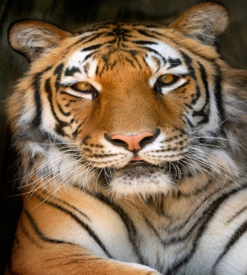

Declarative Sentences
This type of sentence makes a statement. It ‘tells’ you something. These kind of statements usually end with a period but sometimes they can end with an exclamation mark.
That tiger is big!
Women’s basketball has grown in popularity.

Slide 5


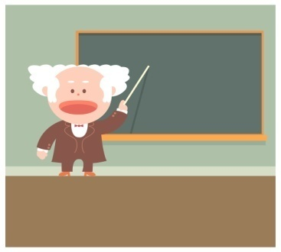
Imperative Sentences
This kind of sentence gives a direction or a command. They can end with a period or an exclamation mark depending on the feeling put into it.
Please, stop yelling!
Turn off the microphone.
Write down your answer.

Slide 6

Exclamatory Sentences
This type of sentence shows strong emotion. It ends with an exclamation mark. Exclamatory sentences begin with the words “what” or “how”.
How beautiful these flowers are!
What a big tiger!

Slide 7
What Kind of Sentence is it?
Directions Using your clicker Decide whether each sentence is Imperative, Exclamatory, Declarative or Interrogative.

